Slide 1
Preschool Supply List
2023-2024

Slide 2
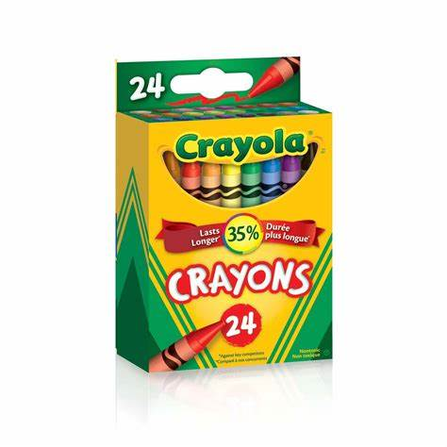
2 packs of Crayola 24 count Crayons

Slide 3
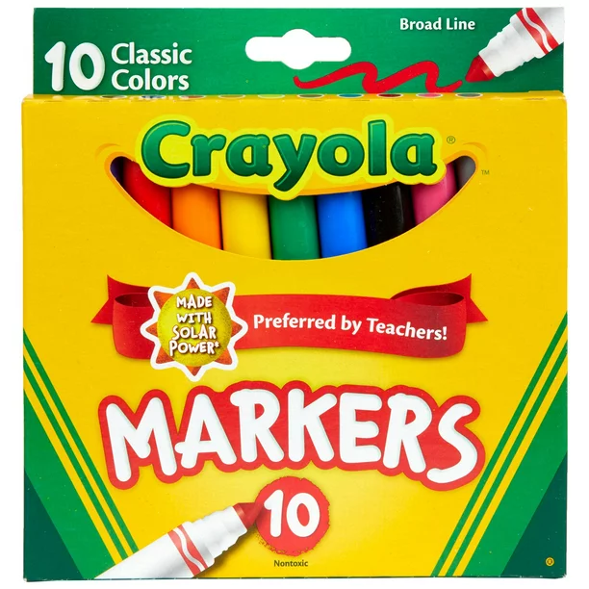
1 Pack Crayola Thick Markers

Slide 4
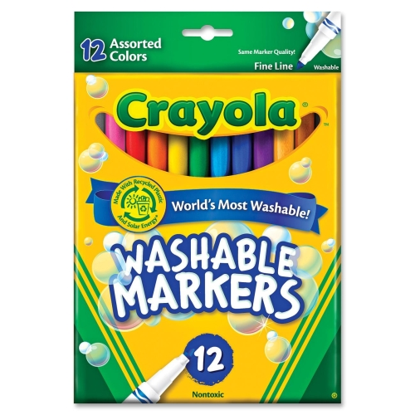
1 Pack Crayola Thin Markers

Slide 5
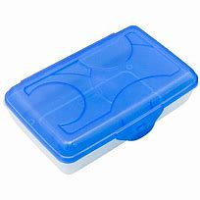
2 Hard Plastic Crayon Boxes

Slide 6
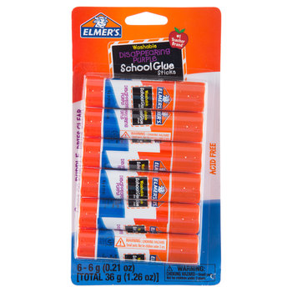
8 Elmers Glue Sticks (Non scented)

Slide 7
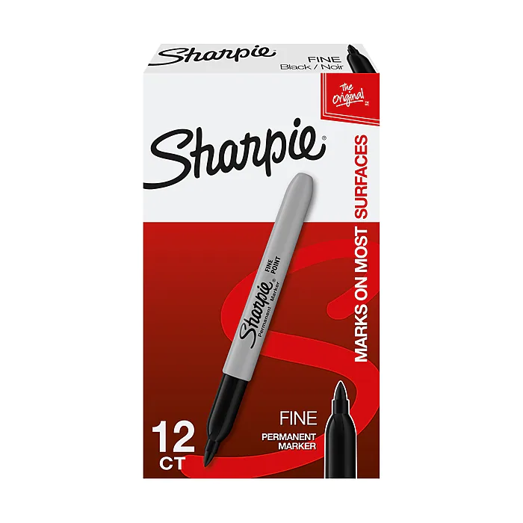
1 pack of Black Sharpies

Slide 8
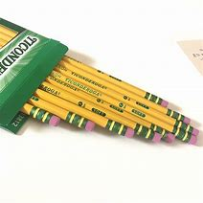
1 Pack of #2 Pencils (Non Mechanical)

Slide 9
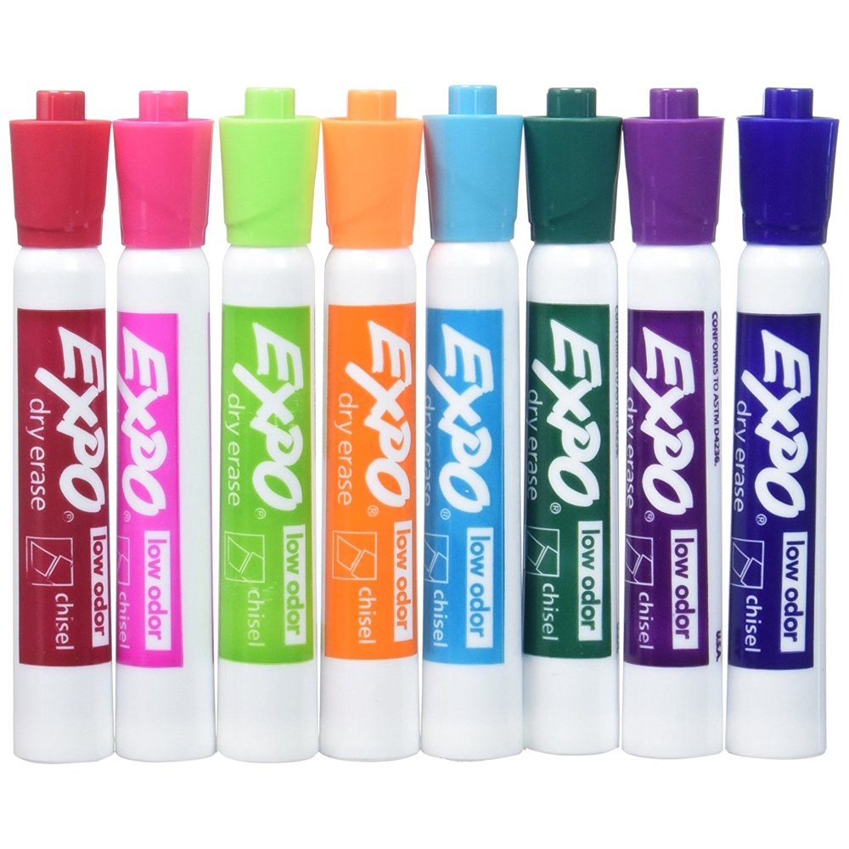
1 Pack Dry Erase Markers

Slide 10
2 1-inch Binders with pockets

Slide 11
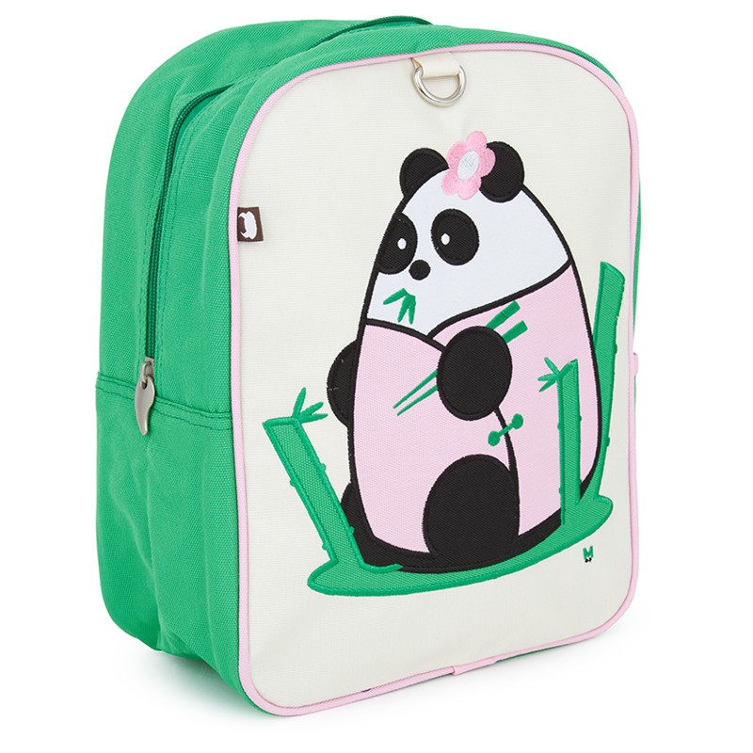
1 School Backpack

Slide 12
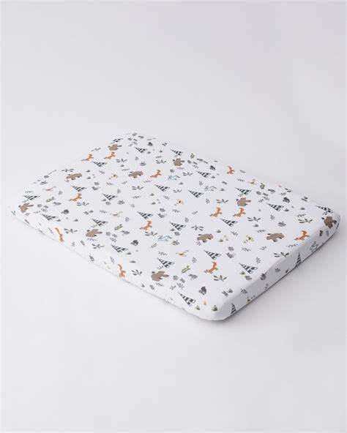
1 Pillow, blanket, and crib sheet for nap time may use a happy napper!

Slide 13
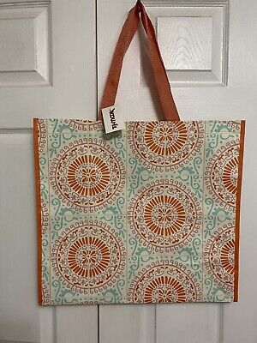
1 bag for nap items

Slide 14
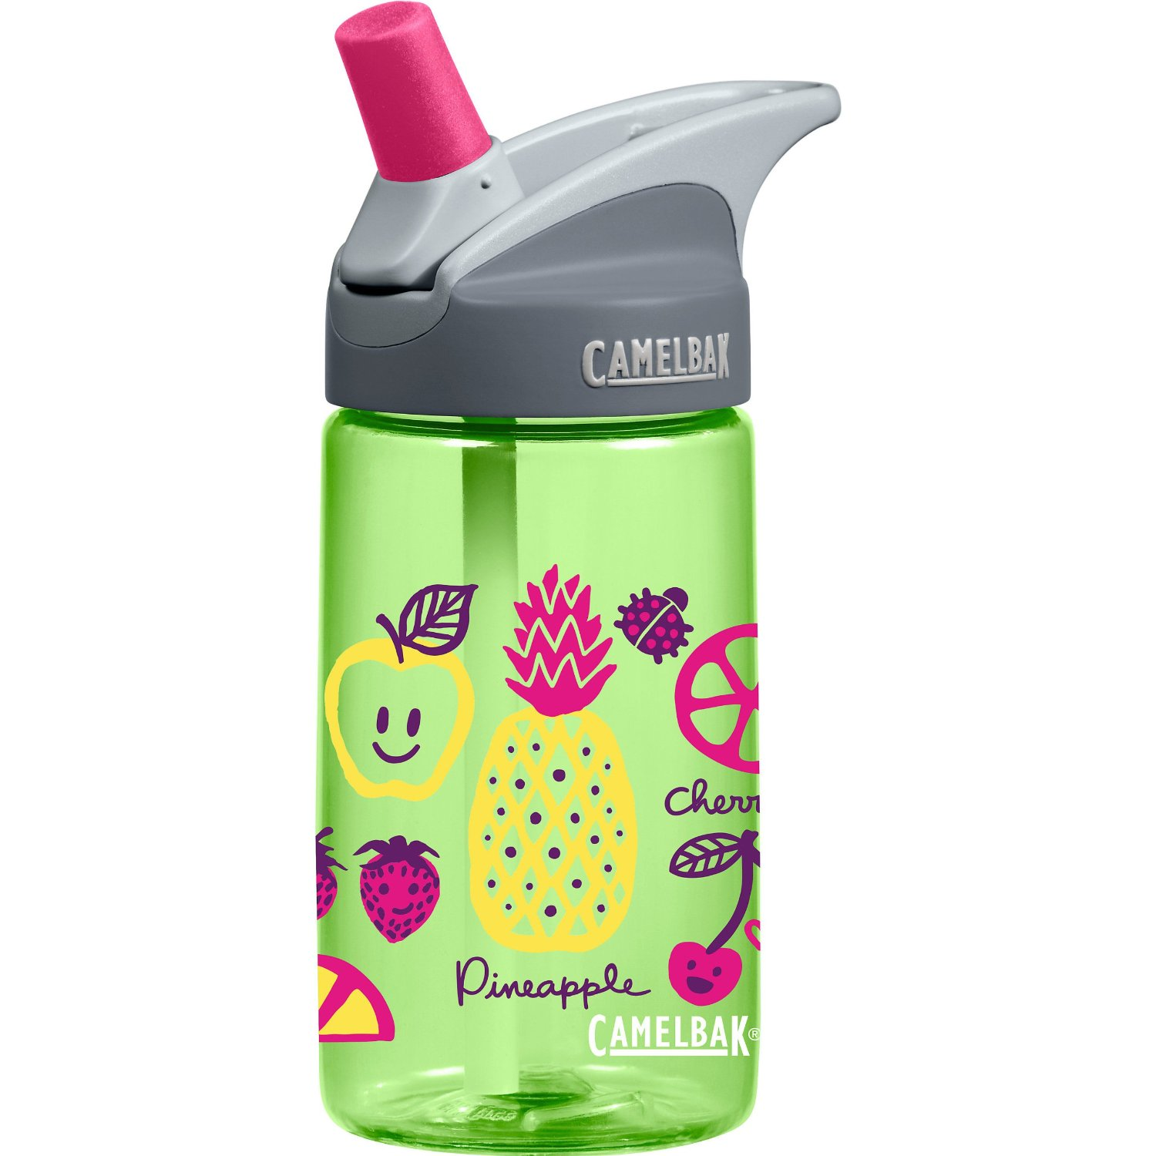
1 Reusable Water Bottle with lid and straw

Slide 15
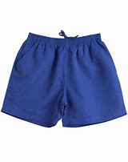
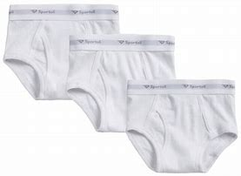
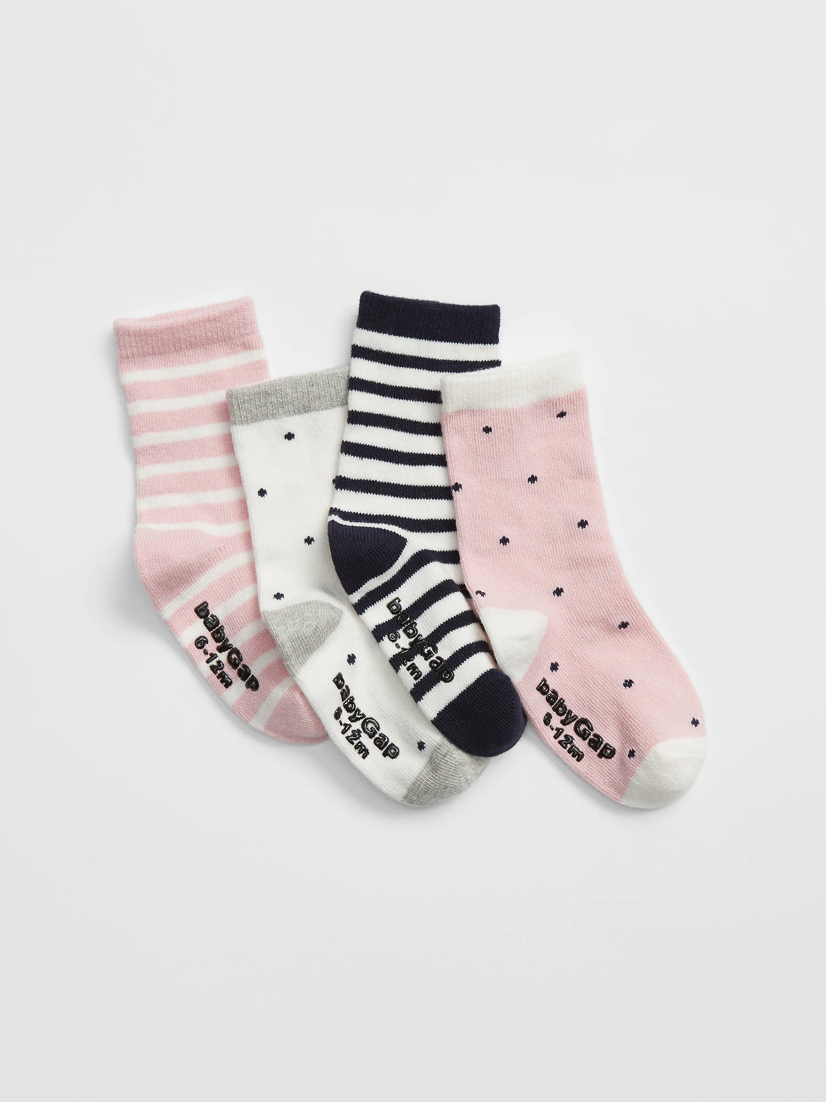
1 Change of Clothes in case of accident (change out seasonal)

Slide 16
2 boxes of tissues

Slide 17
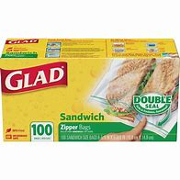
1 Box of sandwich bags

Slide 18
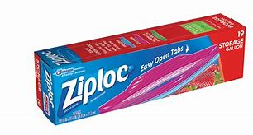
1 Box of Gallon bags

Slide 19
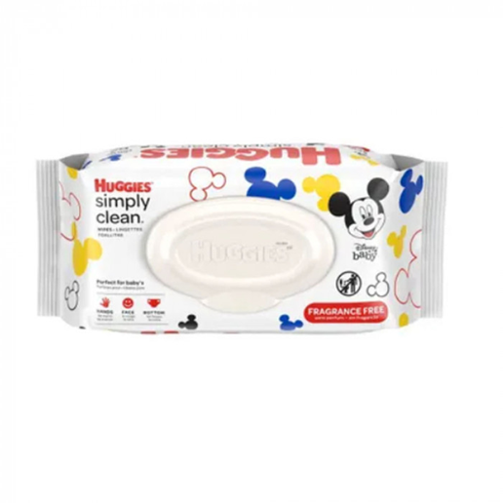
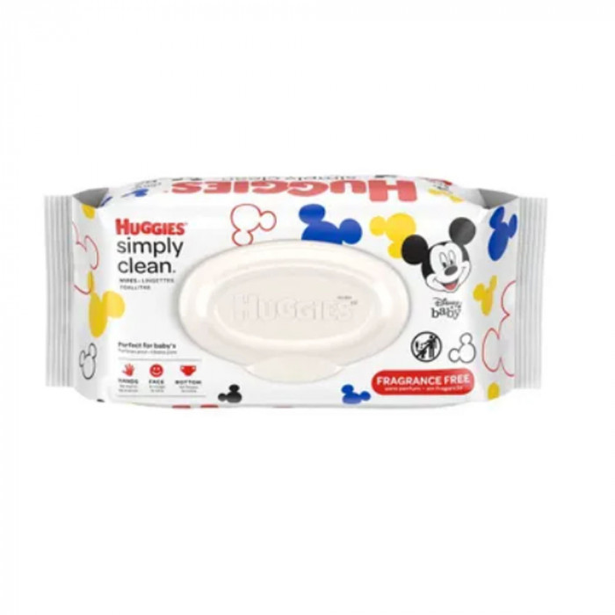
4 packs of baby wipes

Slide 20
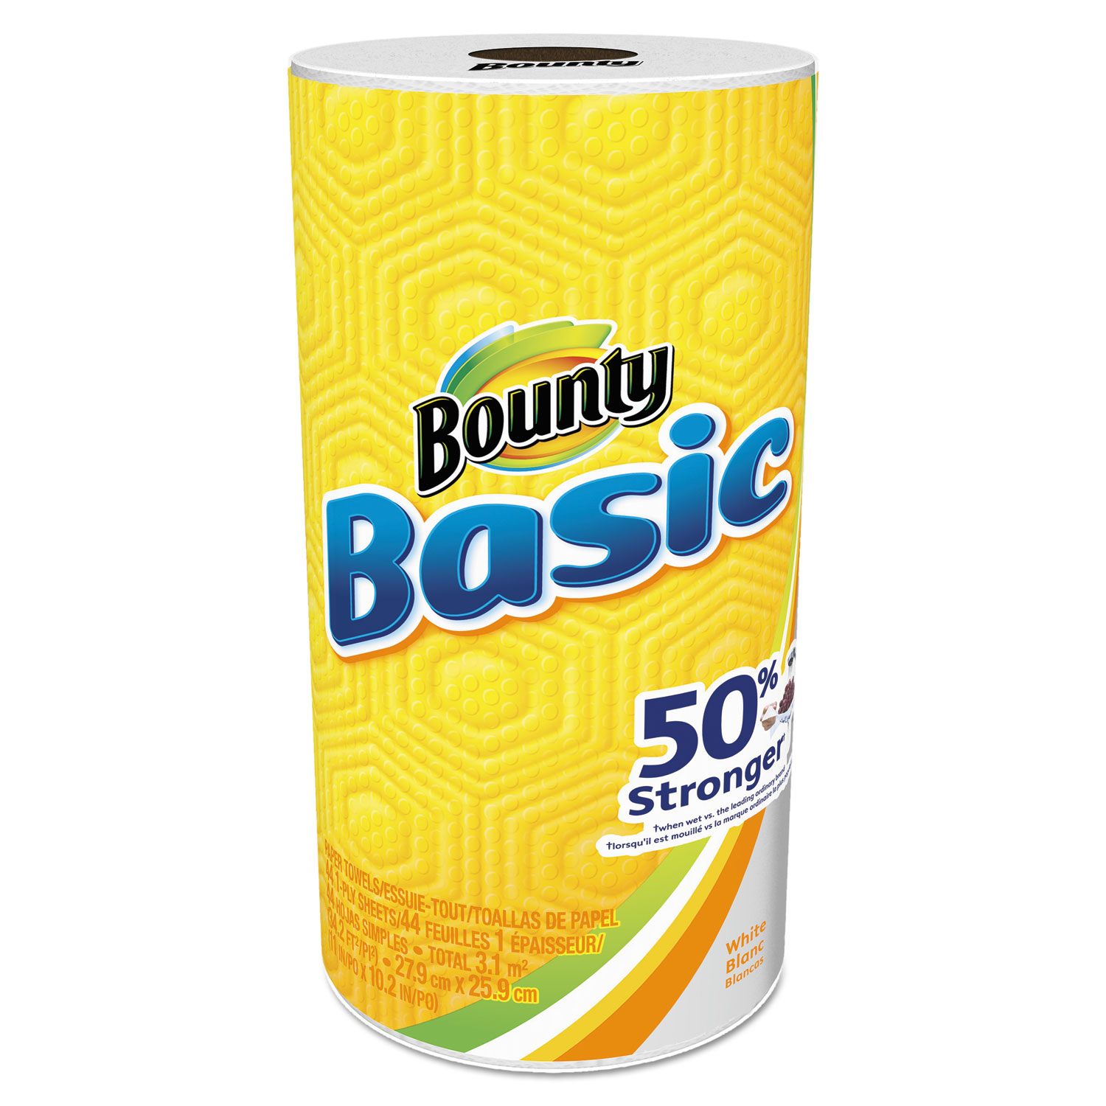
2 Rolls of paper towels

Slide 21
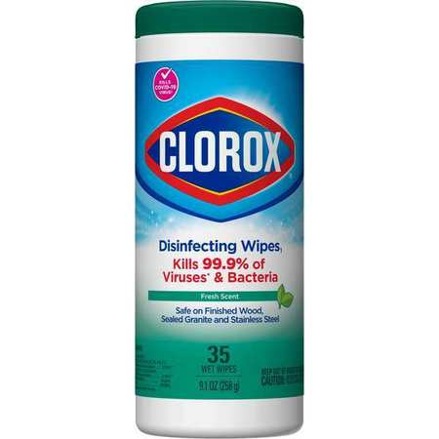
2 containers of disinfectant wipes

Slide 22
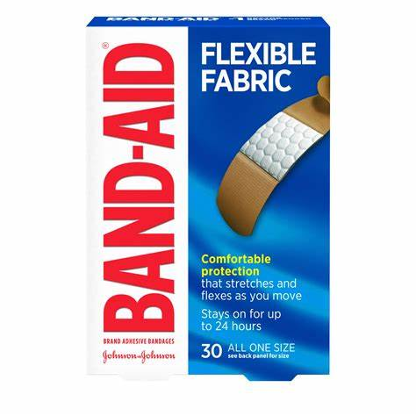
1 box of band aids

Slide 23
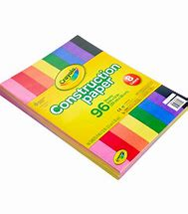
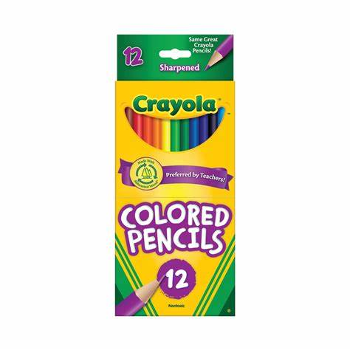
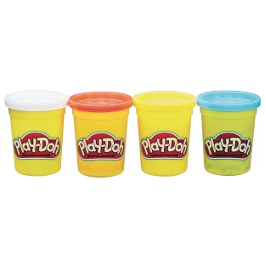
OPTIONAL ITEMS
1 pack of printer paper
1 pack of construction paper
1 pack of protective sheet covers
1 pack of colored pencils
Playdough

Slide 24
THANK YOU!!!
WE CAN’T WAIT TO SEE YOU AT THE ICE CREAM SOCIAL!!!

