Slide 1
Kindergarten Supply List
Ms. Pamer

Slide 2
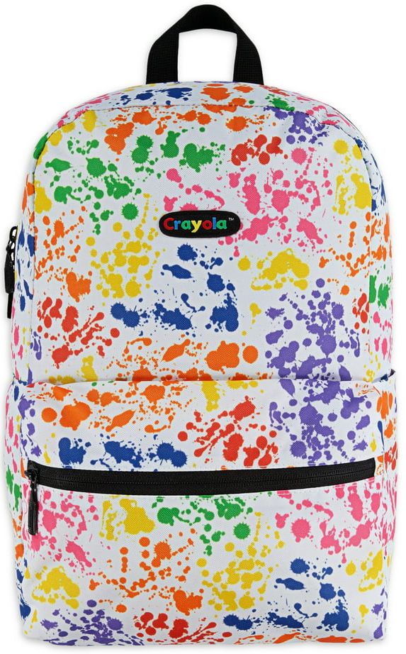
Backpack
(no wheels)

Slide 3
Reusable Water Bottle
With Spill Proof Lid

Slide 4
Headphones
(must cover ears)

Slide 5
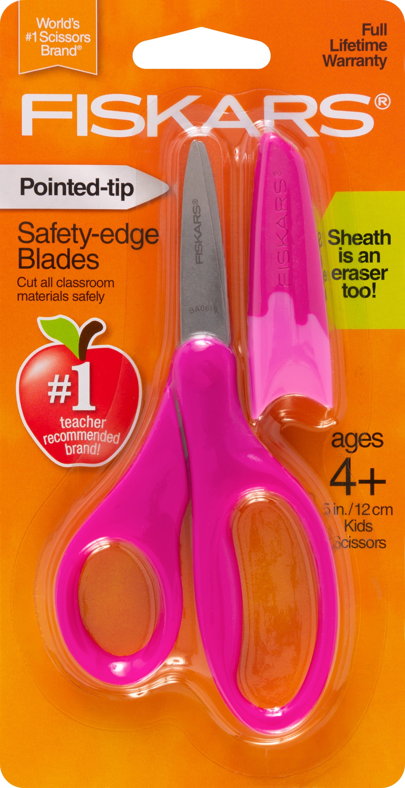
1
Pair of
Fiskars Scissors
(with sheath to cover metal part)

Slide 6
3
Packs of Crayola Crayons

Slide 7
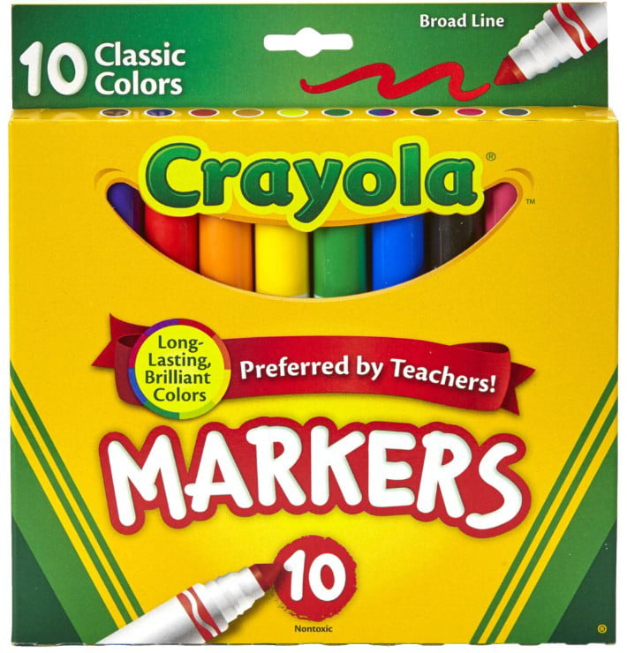
1
Pack of
Crayola Thick Markers

Slide 8
1
Pack of
Crayola Thin Markers

Slide 9
1
Pack of
Crayola Colored Pencils

Slide 10
1
Pink Eraser

Slide 11
1
Pack of
#2 Pencils
(not mechanical)

Slide 12
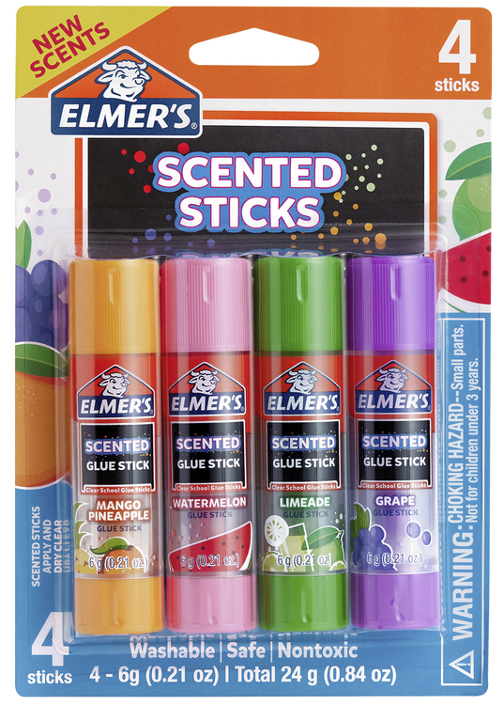
10
Glue Sticks

Slide 13
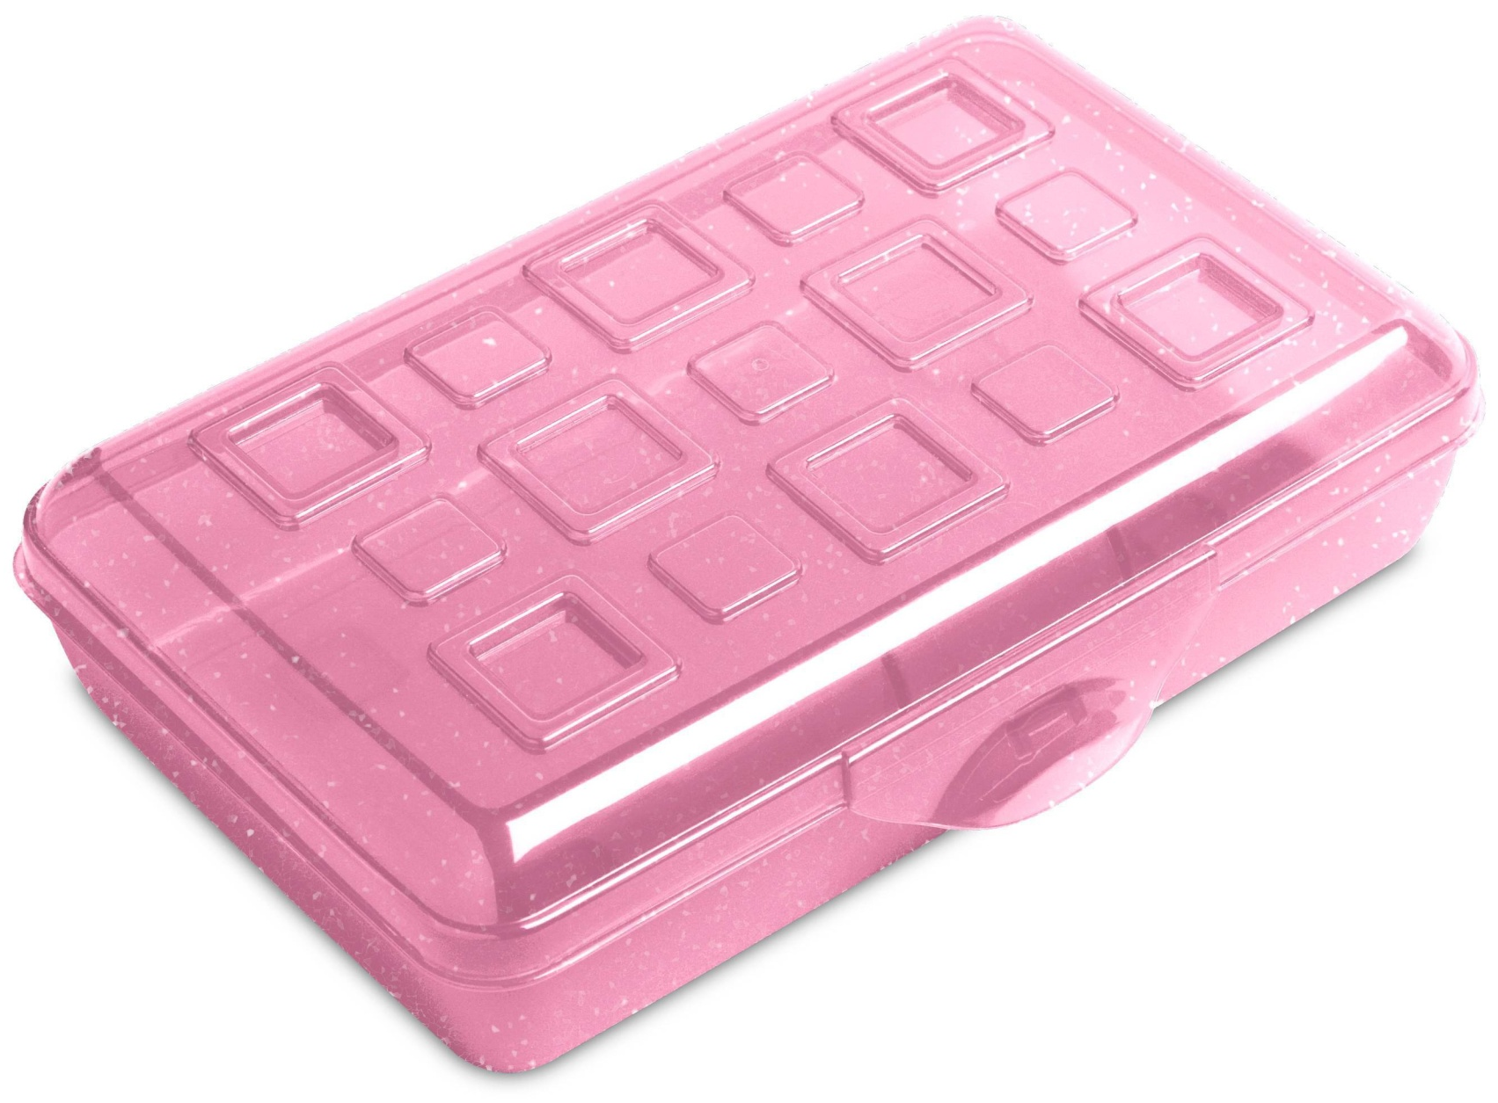
1
Pencil Box

Slide 14
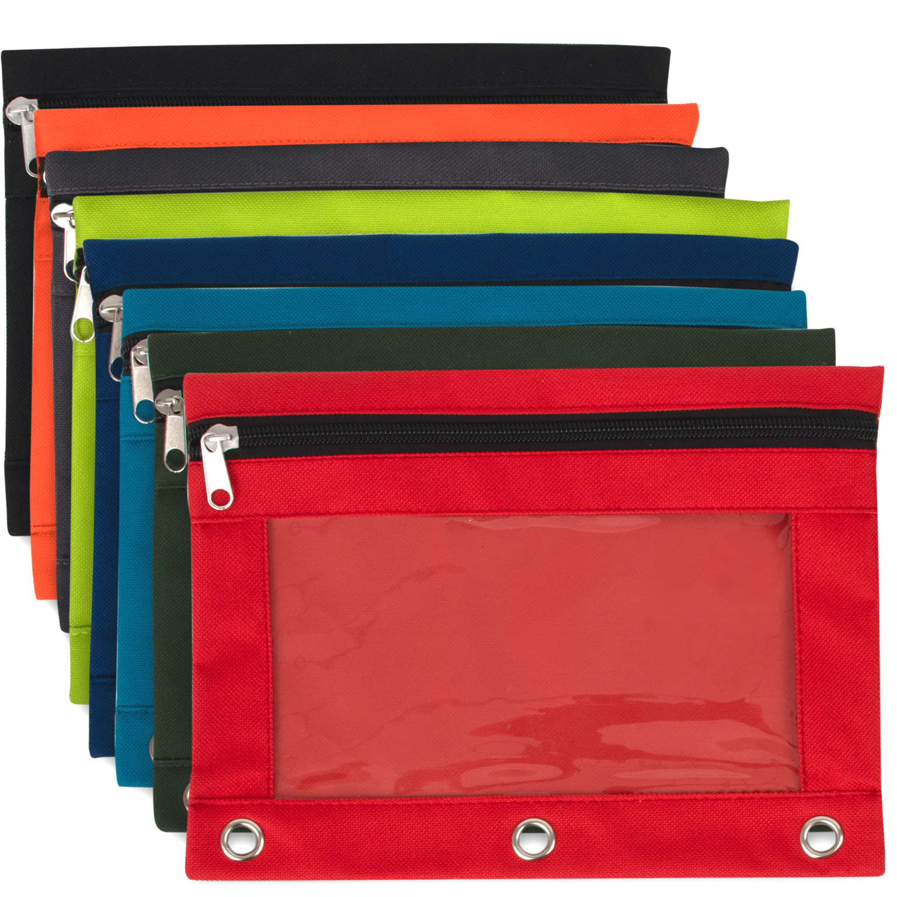
2
Soft Pencil Bags with Holes

Slide 15
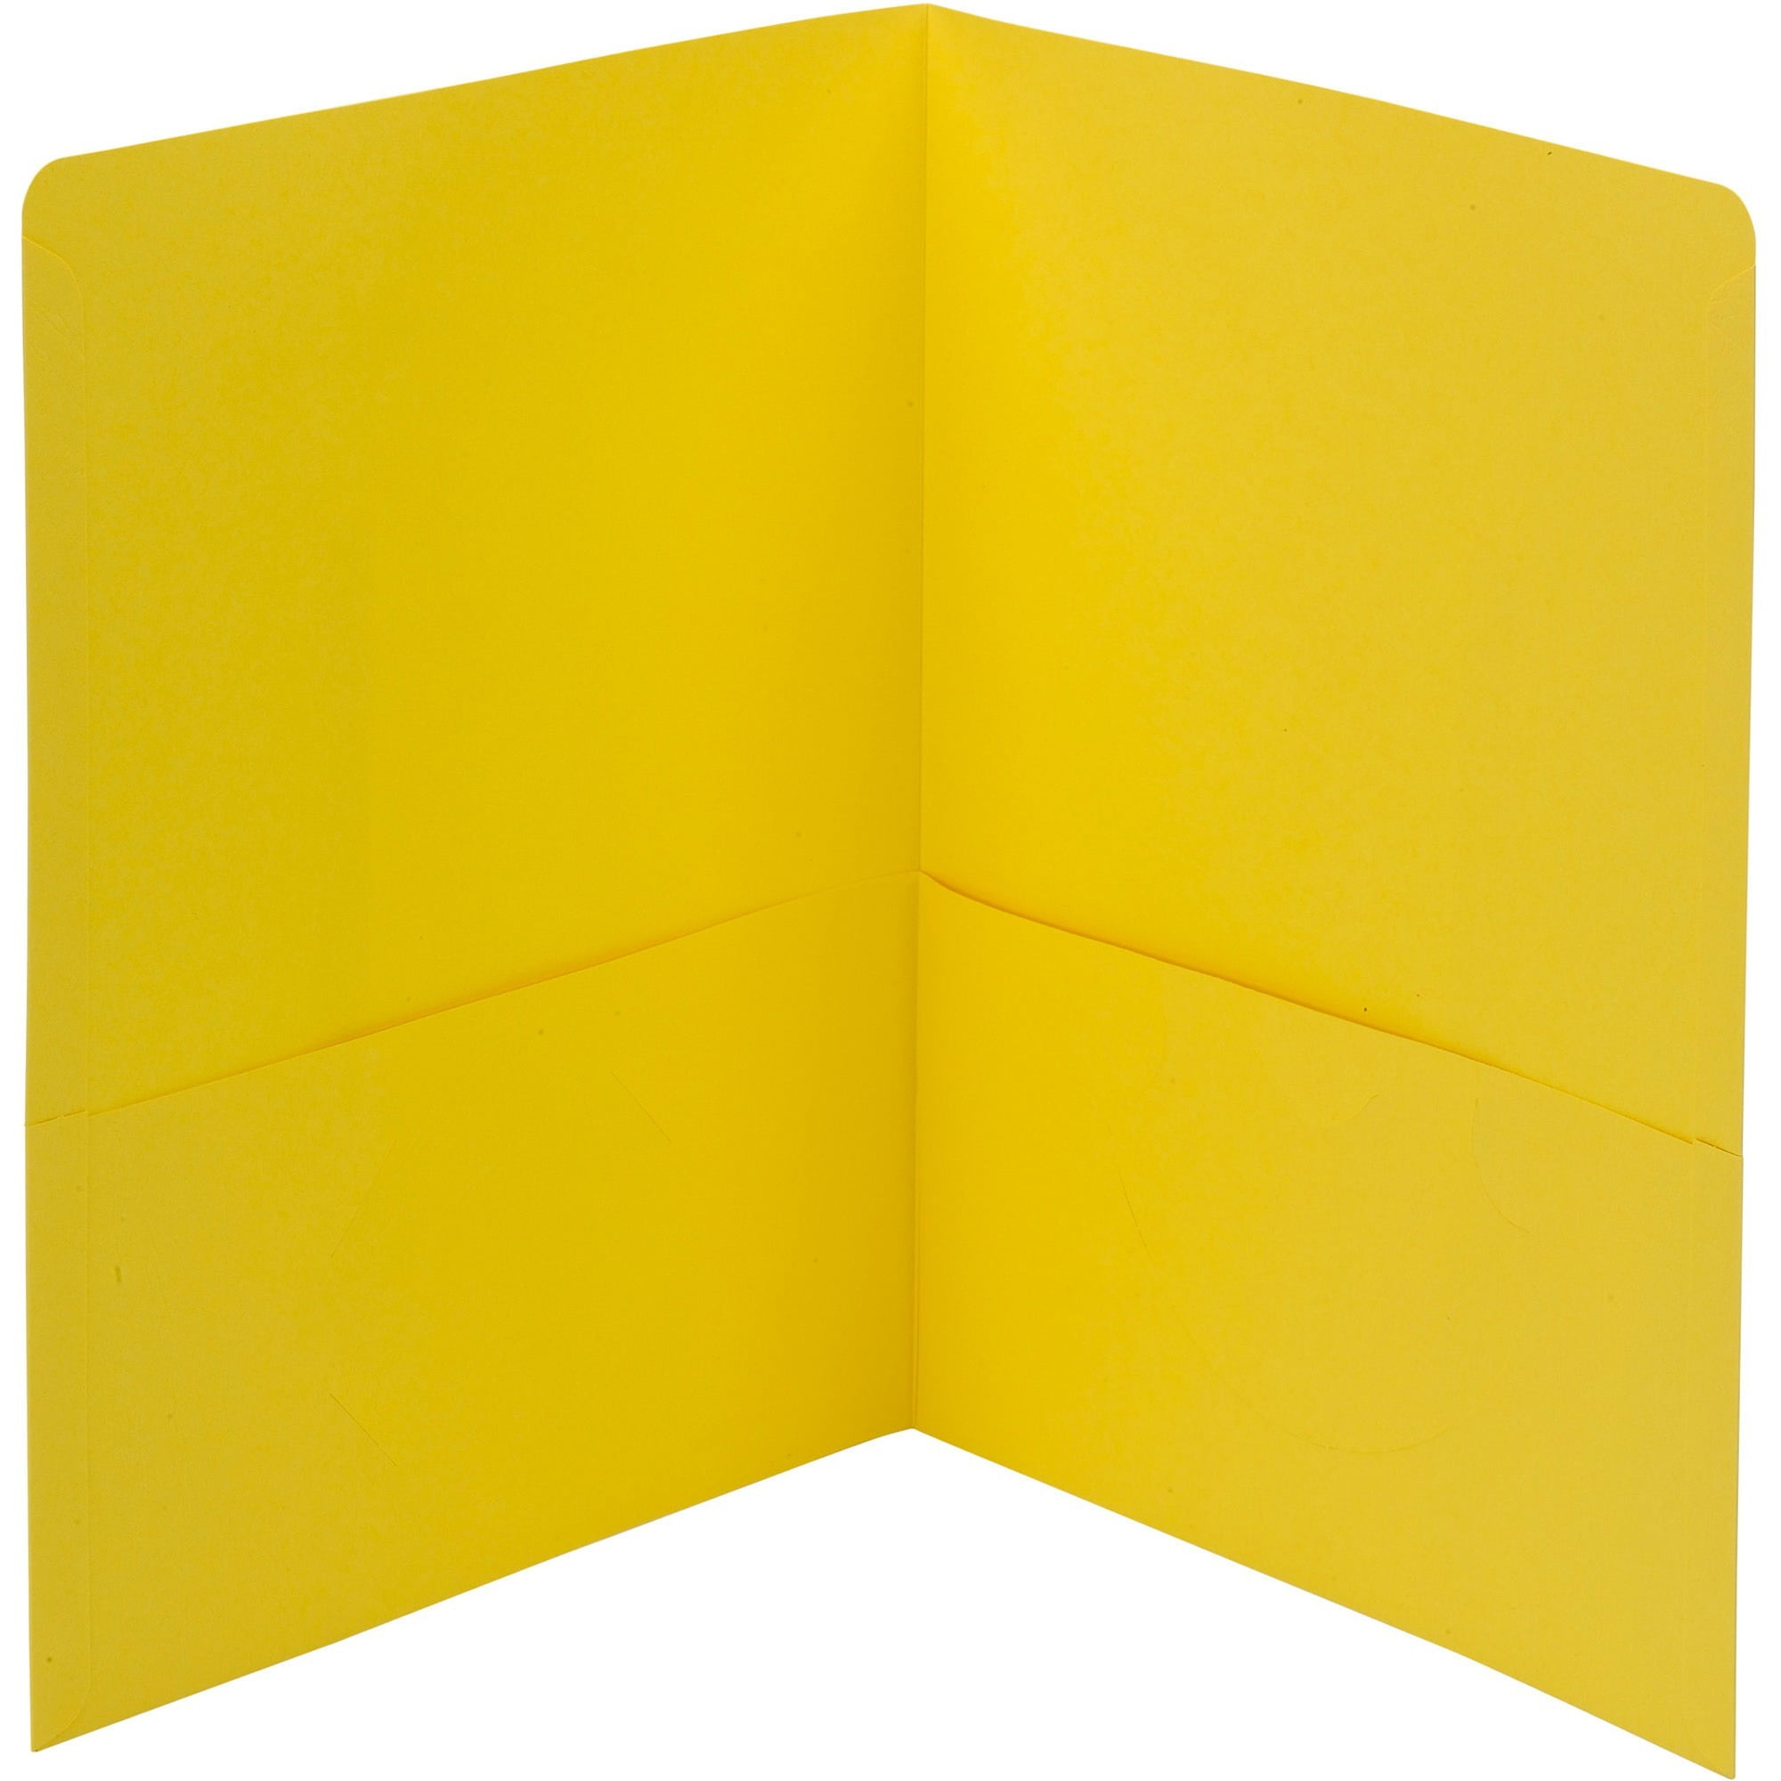
Yellow Folder
(for Religion)

Slide 16
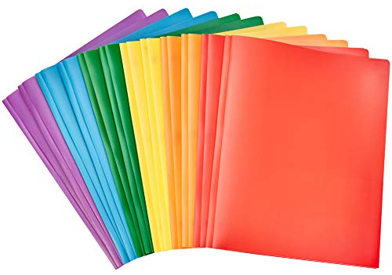
2
Folders
(Any Color)

Slide 17
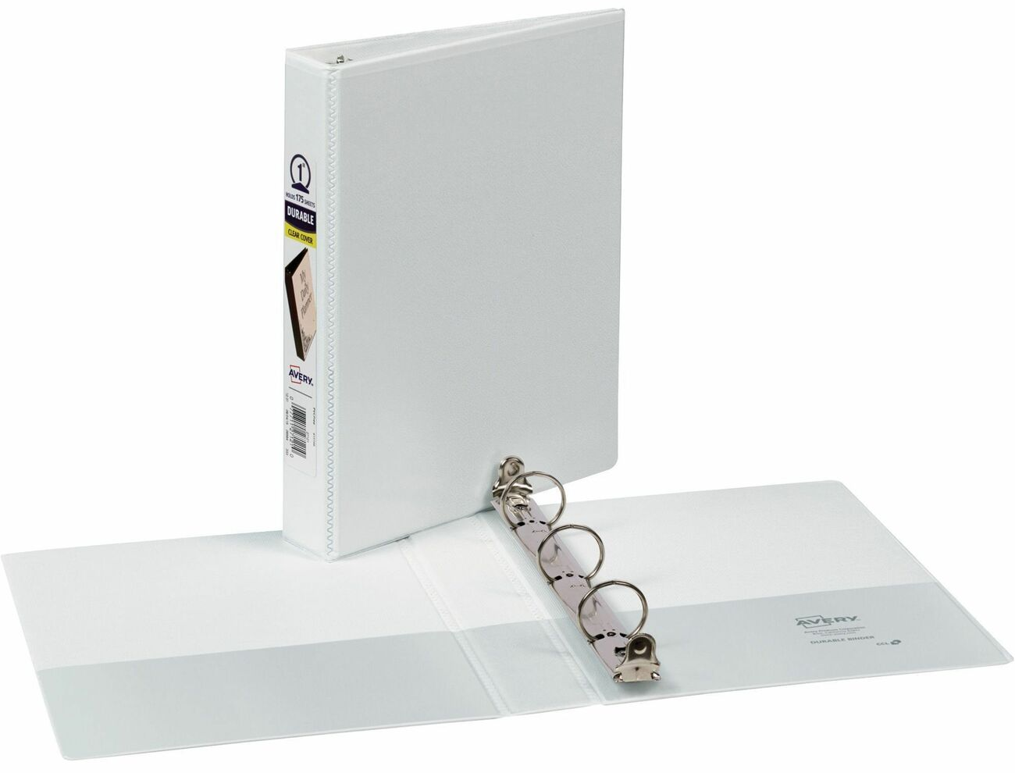
2
1-inch Binder with Pockets

Slide 18
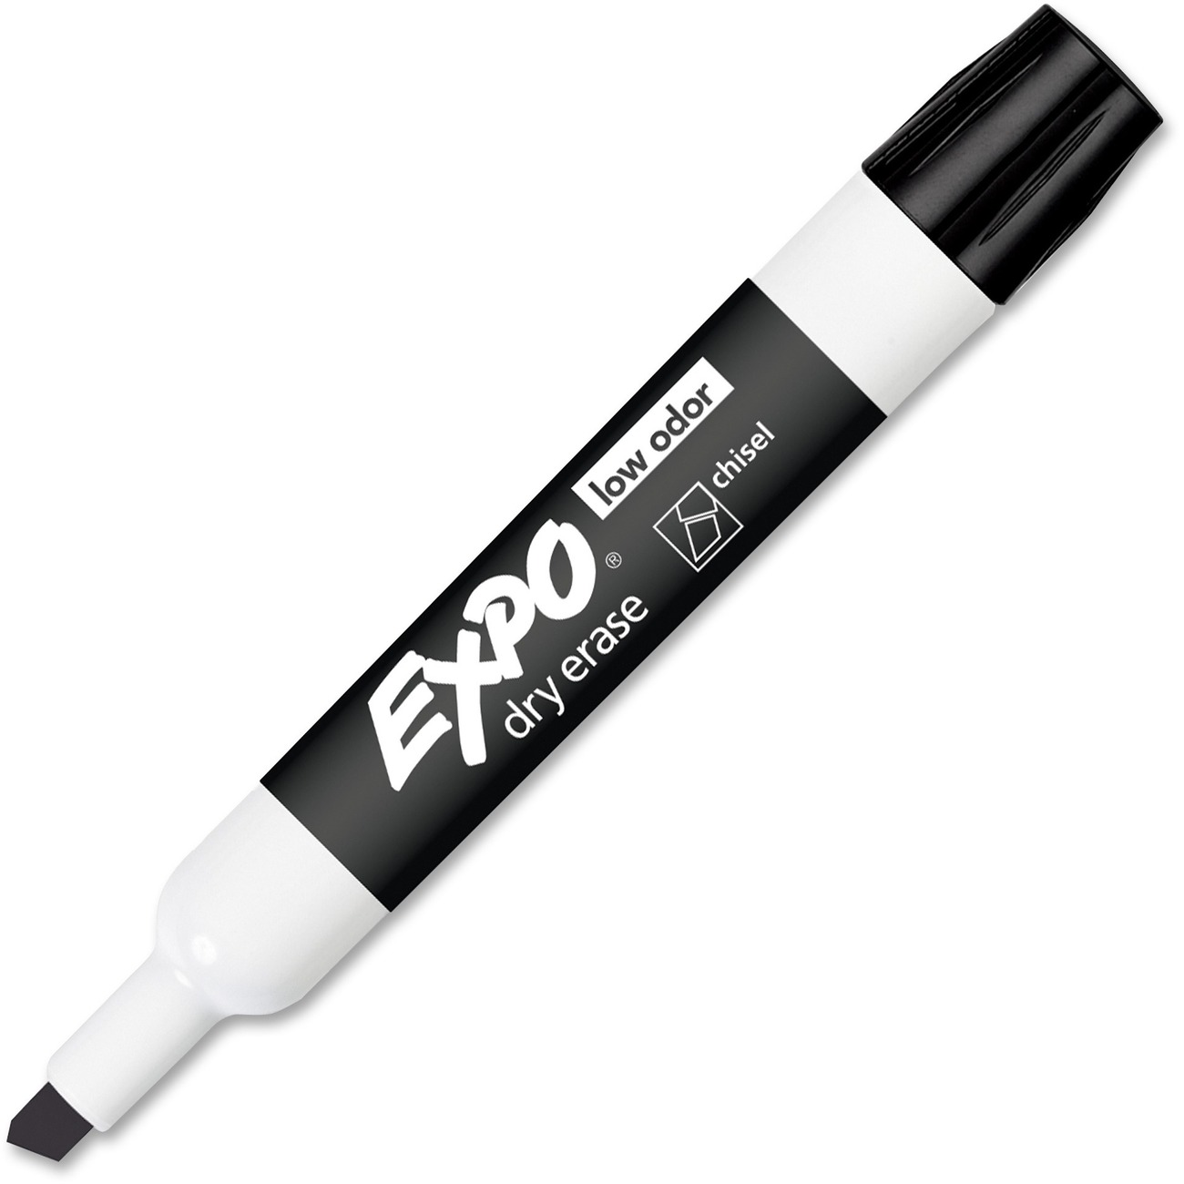
2
Black
Dry Erase Markers

Slide 19
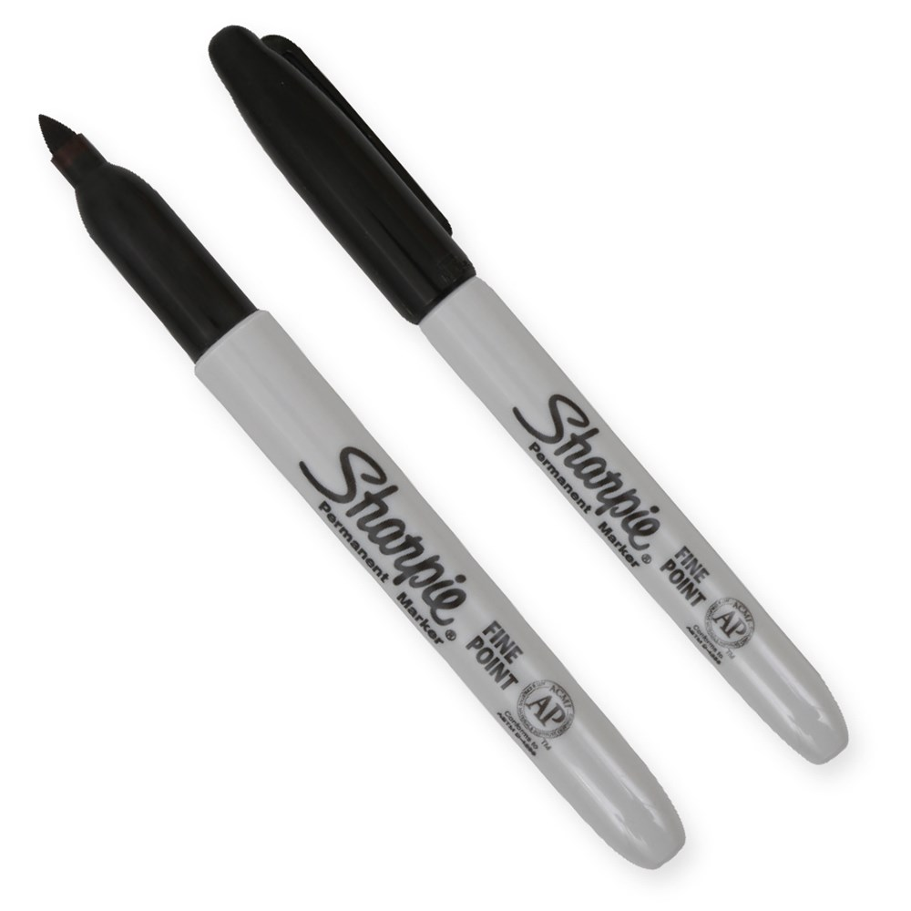
2
Black Sharpies

Slide 20
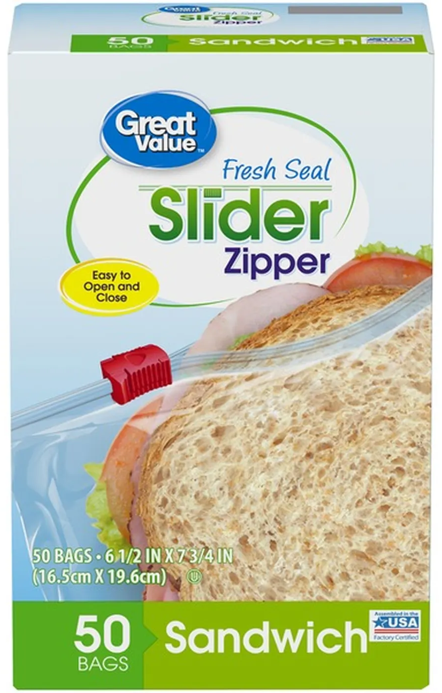
1
Box of Sandwich Bags

Slide 21
1
Box of Gallon Bags

Slide 22
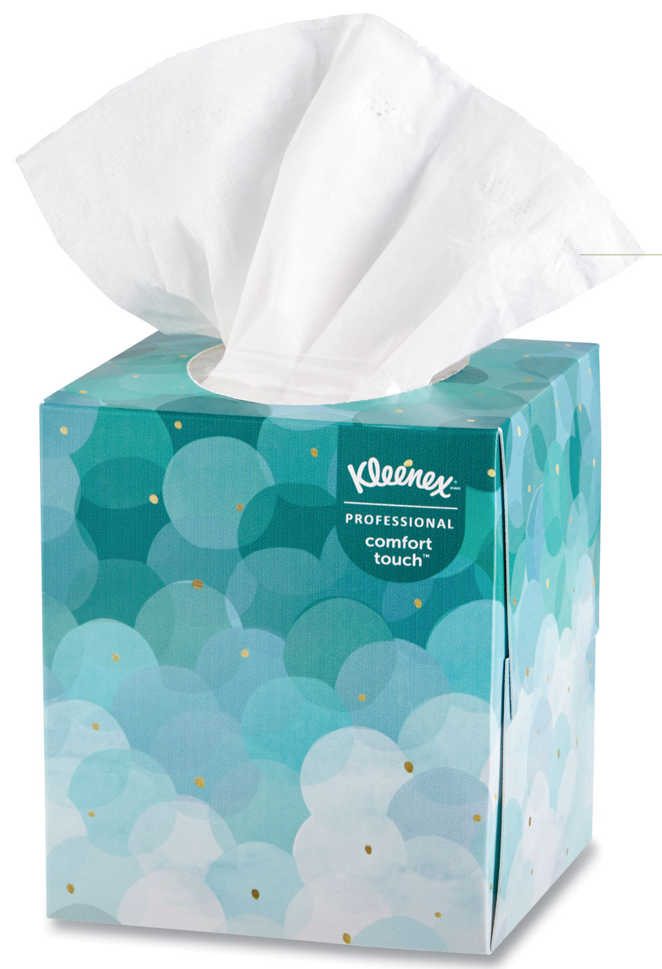
3
Boxes of Tissues

Slide 23
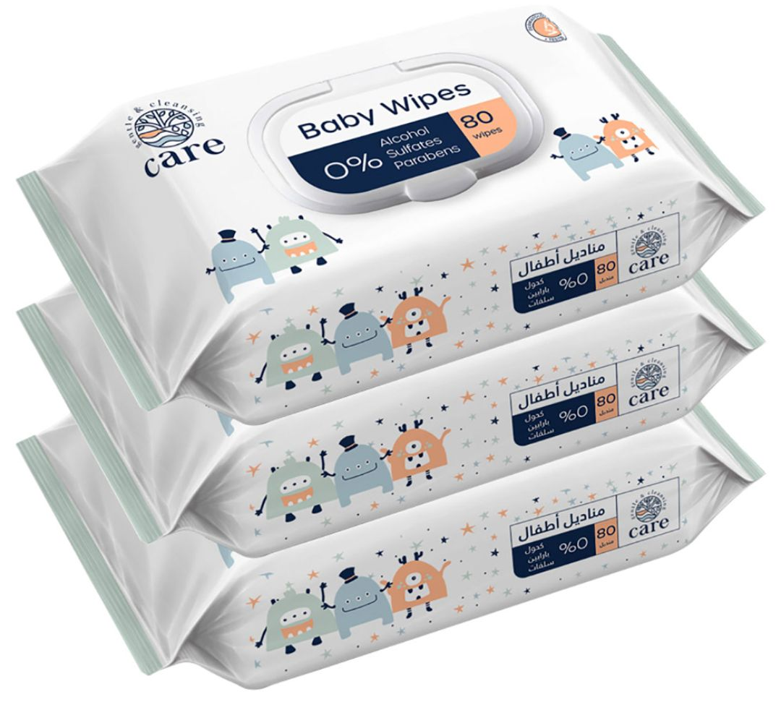
2
Pack of Baby Wipes

Slide 24
2
Lysol/Clorox
Wipes

Slide 25
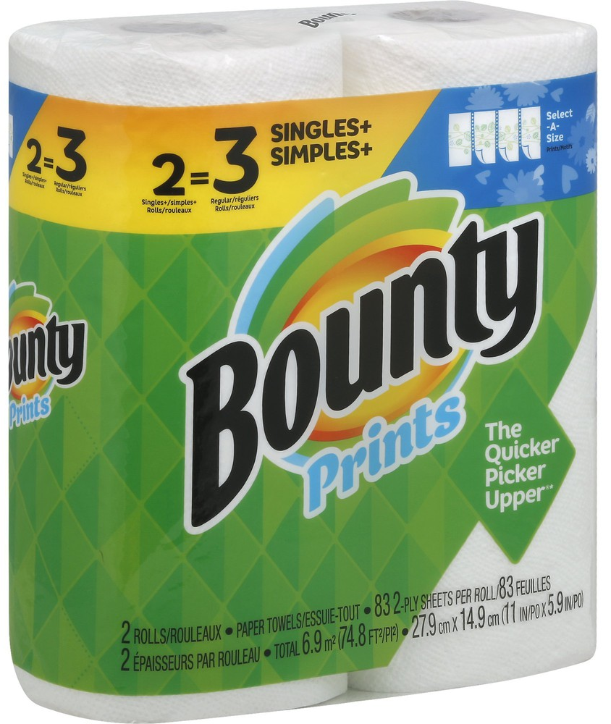
2
Rolls of Paper Towels

Slide 26
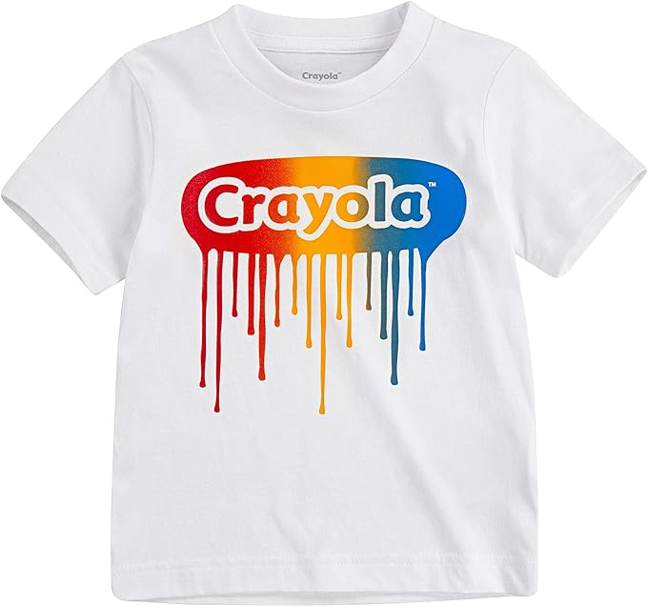
Paint T-Shirt
(for Art)

Slide 27
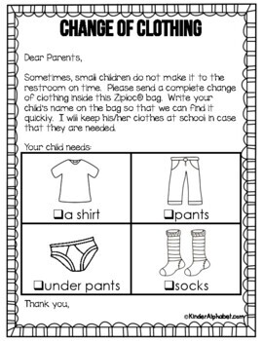
1
Change of Clothes (Underwear, Pants, Shirt,
and Socks)

